Slide 1

Session Name:
Fundamental Concepts of Optimization
Delivered By:
Mr. Ritwik Sinha

Slide 2

Optimization
Finding out the best possible solution to a problem, provided CONSTRAINTS.
Constraints are nothing but CONDITIONS.
Key components of Optimization are:-
Objective Function
Decision Variables
Constraints
Feasible Region
Optimization Algorithm

Slide 3

Learning Objectives
By the end of this session, you will be able to:
Define the overview of optimization process.
Discuss the fundamental concepts of optimization.
Understand the principles of optimization.
Define the objective functions and decision variables.

Slide 4
Optimization
What is Optimization function:- Process of finding the best input values for a given function
Goal:- Maximize or Minimize the given function
Application:- For MAXIMIZING profit and MINIMIZING costs, utilizing Machine Learning algorithm to minimize error or maximize accuracy
Principles of Optimization:-
Define a CLEAR objective function
Consider CONSTRAINTS accordingly
Utilize OPTIMALITY whenever required
Balance TRADE-OFFS in multi-objective problems
Ensure EFFICIENCY and ROBUSTNESS in mathematical computations

Slide 5
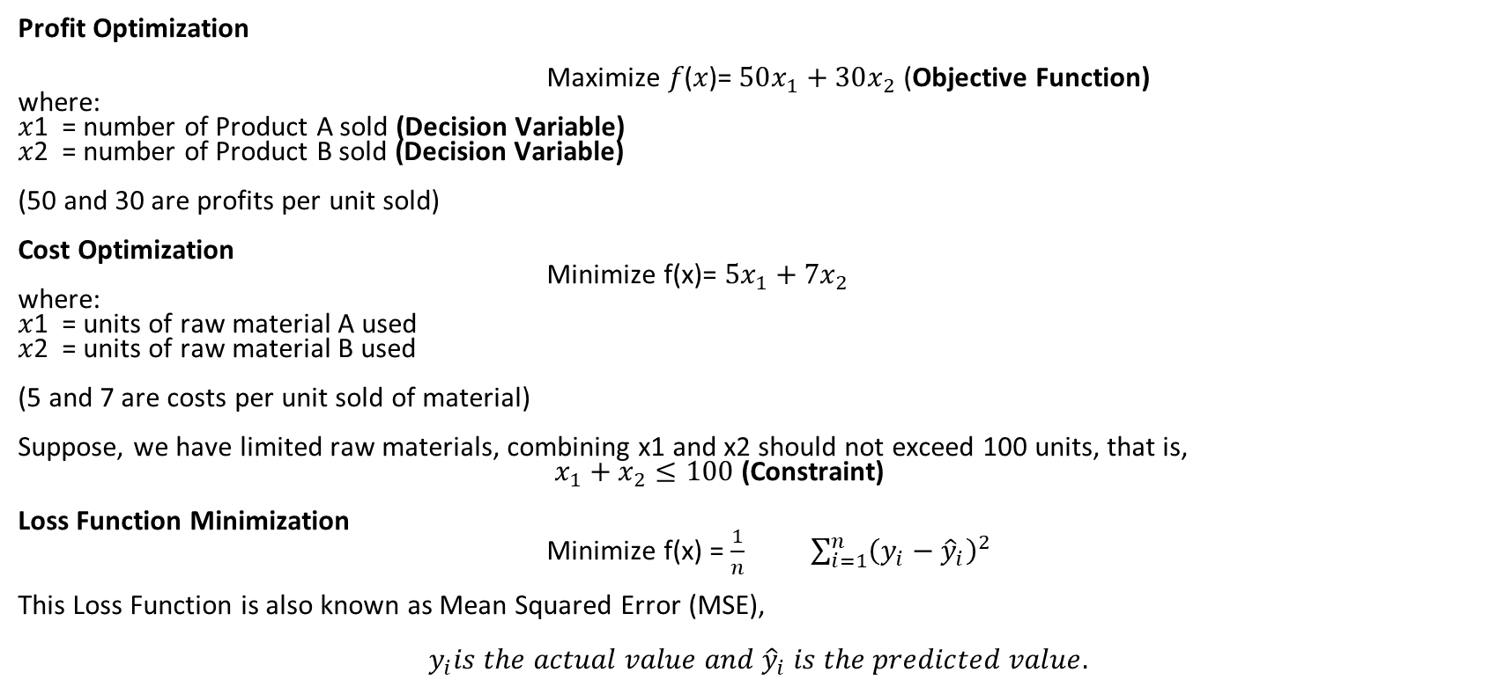
Case Study / Business Application
Profit Optimization
Maximize 𝑓(𝑥)= $50x_{1}+30x_{2}$ (Objective Function)
where:
𝑥1​ = number of Product A sold (Decision Variable)
𝑥2 = number of Product B sold (Decision Variable)
(50 and 30 are profits per unit sold)
Cost Optimization
Minimize f(x)= $5x_{1}+7x_{2}$​
where:
𝑥1​ = units of raw material A used
𝑥2 = units of raw material B used
(5 and 7 are costs per unit sold of material)
Suppose, we have limited raw materials, combining x1 and x2 should not exceed 100 units, that is,
$x_{1}+x_{2}≤100$ (Constraint)
Loss Function Minimization
Minimize f(x) = $\frac{1}{n}$ $\sum_{i=1}^{n}{{\left(y_{i}−{\hat{y}}_{i}\right)}^{2}}$
This Loss Function is also known as Mean Squared Error (MSE),
$$y_{i}is the actual value and {\hat{y}}_{i} is the predicted value.$$

Slide 6
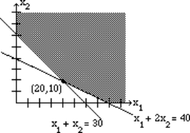
Feasible Region and Optimization Algorithm
Feasible Region
This is a common region determined by all the constraints including all the problem’s constraints.
Optimization Algorithm
This is a mathematical method used to find the best solution.
For instance, some of the optimization algorithms are Gradient Descent, Simplex Method, Adaptive Moment Estimation, Lagrange Multipliers

Slide 7
Academic Poll
Which of the following statements about optimization is correct?
An optimization problem always has a unique solution.
Optimization involves finding the best possible solution within given constraints.
Only maximization problems are considered in optimization.
The feasible region contains only one possible solution.

Slide 8
Academic Poll
Which of the following statements about optimization is correct?
An optimization problem always has a unique solution.
Optimization involves finding the best possible solution within given constraints.
Only maximization problems are considered in optimization.
The feasible region contains only one possible solution.

Slide 9
Academic Poll
Which of the following is an example of a convex optimization problem?
A problem where the objective function is quadratic, and the constraints are linear
A problem where the objective function is non-linear, and the constraints are quadratic
A problem with a non-convex objective function and linear constraints
A problem where both the objective function and constraints are non-convex

Slide 10
Academic Poll
Which of the following is an example of a convex optimization problem?
A problem where the objective function is quadratic, and the constraints are linear
A problem where the objective function is non-linear, and the constraints are quadratic
A problem with a non-convex objective function and linear constraints
A problem where both the objective function and constraints are non-convex

Slide 11
Session Summary
In this session, we have discussed about:
Introduction to Optimization
Principles of Optimization
Objective Functions, Decision Variables and Constraints
Feasible Region and Optimization Algorithm

Slide 12

Happy Learning!

